Slide 1
The Battle of Neighborhoods Raghavendra Kumar Punugu – 11/22/2019

Slide 2
1. Introduction
People relocation – Job, better climatic conditions, Cost of living, better school district etc.
Safety Is the most important factor for relocation
Types of crime and degree of crime are studied based on the available data for London City Crimes for Year 2016
We explored the neighborhood of London City from data obtained from Kaggle for year 2016.
We reported the safest borough and explored the neighborhoods of these borough using K-means clustering
This is helpful for people willing to relocate.

Slide 3
2. Data Cleaning
Dataset 1
The dataset 1 (London Crime) has different columns:
lsoa_code: code for Lower Super output Area in Greater London
borough: Common name for London borough
major_category: high level categorization of crime
minor_category: Low level categorization of crime
value: monthly reported count of categorical crime in given borough
year: Year of reported counts, 2008-2016
month: Month of reported counts, 1-12

Slide 4
Dataset 2
Contains the list of London boroughs which is obtained from wikipedia. It contains the following columns:
Borough: Names of Borough in London
Inner: Categorizing the borough as Inner London Borough or an Outer London Borough
Status: Categorizing the borough as Royal, City or other
Local Authority: Local Authority assigned to that borough
Political Control: Political party that controls the borough
Headquarters: HQ of the borough
Area (sq mi): Area of the borough
Population: Population in the borough
Nr. In map: The number assigned to each borough to represent on a map

Slide 5
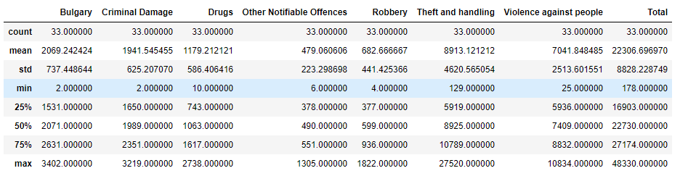
3. Methodology
Exploratory Data Analysis
Theft and handling is the highest reported crime in year 2016 followed by Violence against person, Burglary, Criminal Damage and so on. Other Notifiable offences is lowest in reported crime for year 2016.

Slide 6
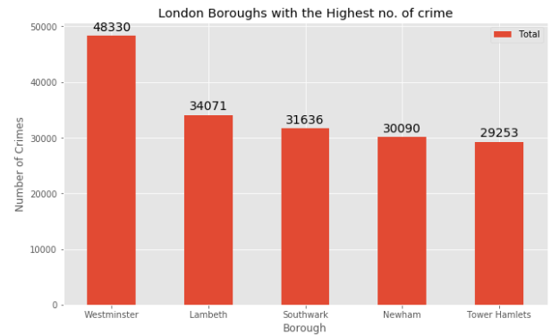
Above figure represents the London Borough with Highest number of crimes reported in descending order. Westminster has the highest number of reported crimes which is 48330 which is followed by Lamberth (34071), Southwark (31636), Newham(30090) and Tower Hamlets (29253).

Slide 7
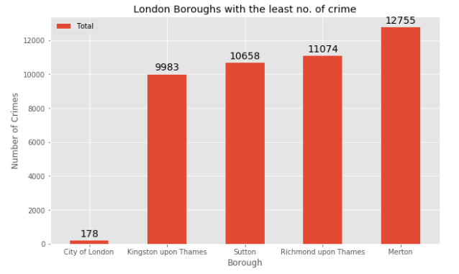
Above figure represents the London borough with least number of Crimes reported for year 2016. City of London has the least number of reported crime of 178 instances among all the Boroughs in London, followed by Kingston upon Thames (9983), Sutton Borough (10658), Richmond upon Thames(11074) and Merton (12755).

Slide 8
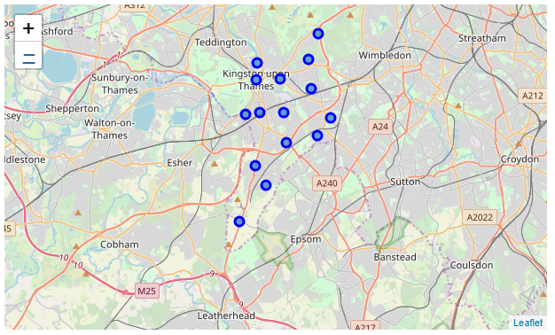
Above figure represents the 15 Neighborhoods in Kingston upon Thames

Slide 9
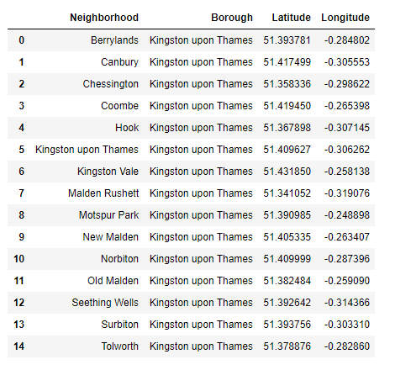
Neighborhoods in Kingston upon Thames

Slide 10
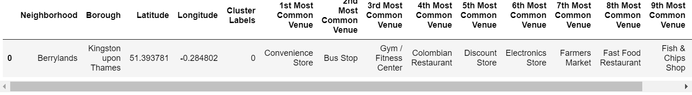
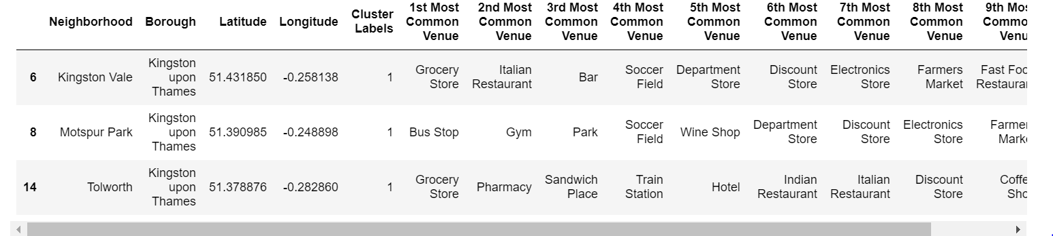
4. Results
Based on the cluster 1, we see that this cluster has just neighborhood which is Berrylands in Kingston upon Thames, and the most common venue is Convenience store followed by Bus Stop and Gym/Fitness center.
Based on Cluster 2 , we see that the borough in cluster 2 has 3 neighborhoods, and among the three neighborhood, the most common venue is Grocery store for Kingston Vale and Tolworth, whereas for Mostspur Park, its most common venue is Bus Stop.

Slide 11
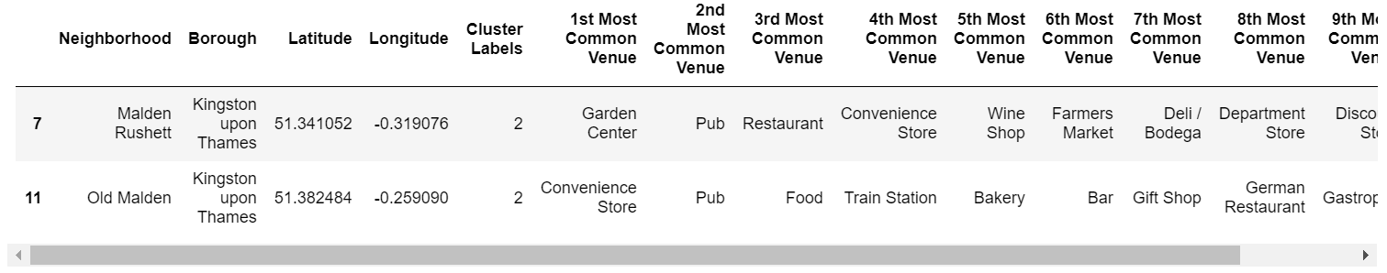
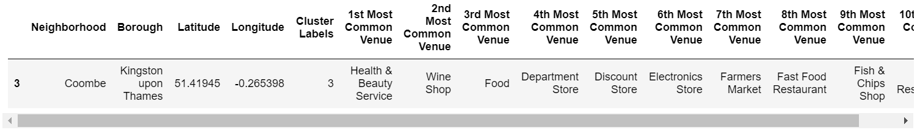
Based on the below table, we see that this cluster has 2 neighborhoods, the most common venue for Maiden Rushett is Garden center where as for Old Maiden it is Convenience Store. Followed by Pub which is the second most common venue for both the neighborhood.
In cluster 4 we have just one neighborhood which is Coombe in Kingston upon James borough, and the most common venue for this neighborhood is Health and Beauty Service followed by Wine Shop.

Slide 12
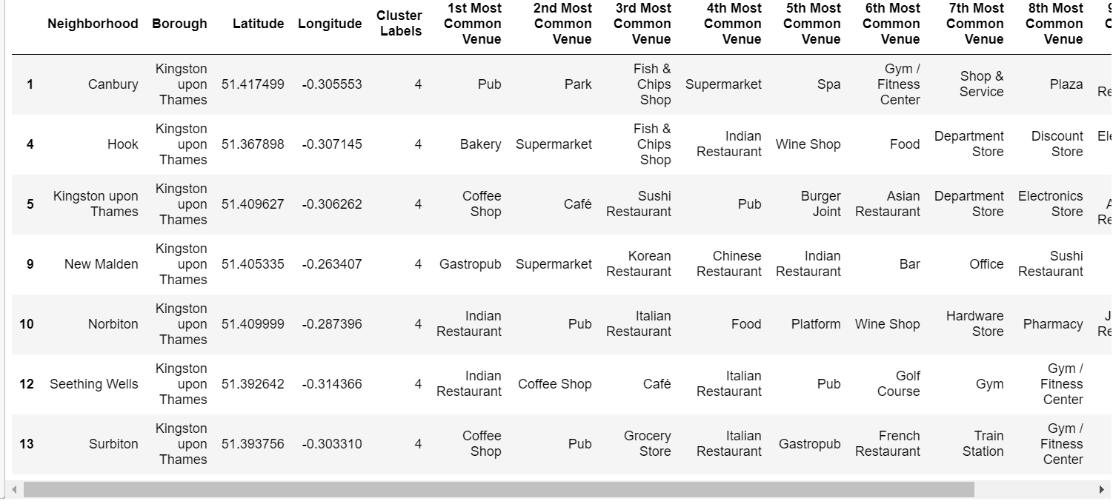
Cluster 5 has the most neighborhoods among the five cluster we have modeled. Indian Restaurant is popular in two neighborhoods of Norbiton and Seething Wells, while Coffee Shop is the most common venue for Kingston upon Thames and Surbiton.

Slide 13
5. Discussions
The aim of this project is to help people migrating to different London Borough to make well informed decisions based on their preferences.
For example, if some one wants to move to a place with Indian restaurant around in his neighborhood he can prefer either Norbiton or Seething Wells, however, if their immediate next preference is a pub they may most likely prefer Norbiton.
A family that prefers to stay in the vicinity of grocery store can choose Kingston vale or Tolworth. The above results would be a significant help for people/ families trying to move to Kingston Upon Thames borough and select the neighborhood which suits their preference.
Also, the clustering was done for 500 m, which in my opinion is not a deal breaker for any person/persons, Some venues may be a little far than the desired distance but then people tend to get a better holistic picture of the neighborhoods and their most common venues.

Slide 14
6. Conclusion
These results will help people make well-informed decisions ahead of their time and is hassle free process. In the future work, we will work on considering several additional factors including cost of living, schooling district etc.

